Slide 1
Physical Layer: Analog & Digital Signals
Covers Chapter# 03 from Text Book
Computer Communication & Networks
(CEN-223)
Fall 2022 (BSE-5A)

Slide 2
Data and Signals
Data needs to be converted into signals for transmission on the communication medium.
Signals can be either analog or digital.
Analog signal: signal that has infinite values (i.e. amplitudes) over a period of time.
Digital signal: signal that has limited values (i.e. amplitudes) over a period of time.

Slide 3
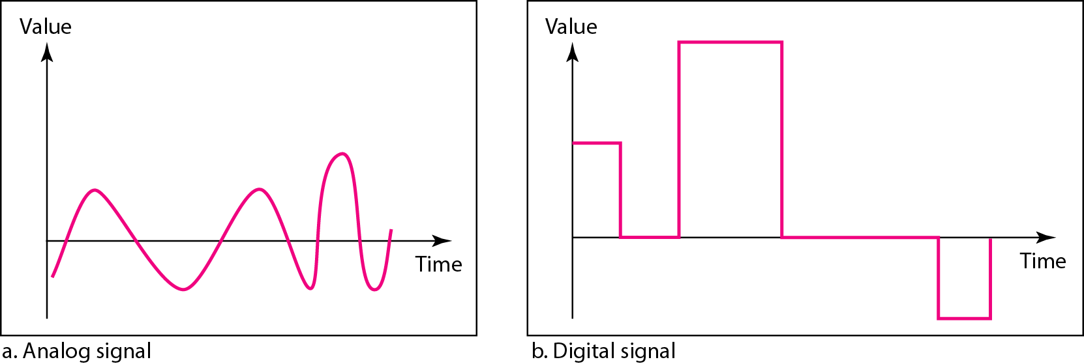
Data and Signals (Cont.)
Comparison of analog and digital signals
Both analog and digital signals can be periodic or non-periodic (i.e. aperiodic).

Slide 4
Periodic and Non-periodic
Periodic signal: a signal that completes a pattern within a measurable time frame, called a period, and repeats that pattern over subsequent identical periods.
Cycle: completion of one full period.
Non-periodic signal: changes without exhibiting a pattern or cycle that repeats over time.
Note: in data communications, we commonly use periodic analog signals and non-periodic digital signals.

Slide 5
Periodic Analog Signals

Slide 6
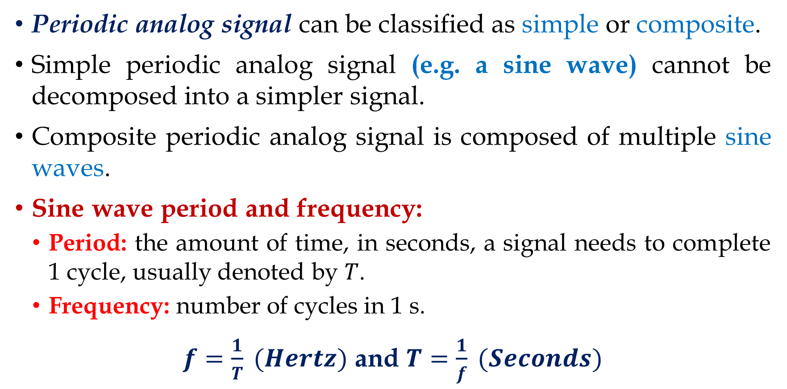
Period and Frequency
Periodic analog signal can be classified as simple or composite.
Simple periodic analog signal (e.g. a sine wave) cannot be decomposed into a simpler signal.
Composite periodic analog signal is composed of multiple sine waves.
Sine wave period and frequency:
Period: the amount of time, in seconds, a signal needs to complete 1 cycle, usually denoted by $T$.
Frequency: number of cycles in 1 s.
$f=\frac{1}{T} (Hertz)$ and $T=\frac{1}{f} (Seconds)$

Slide 7
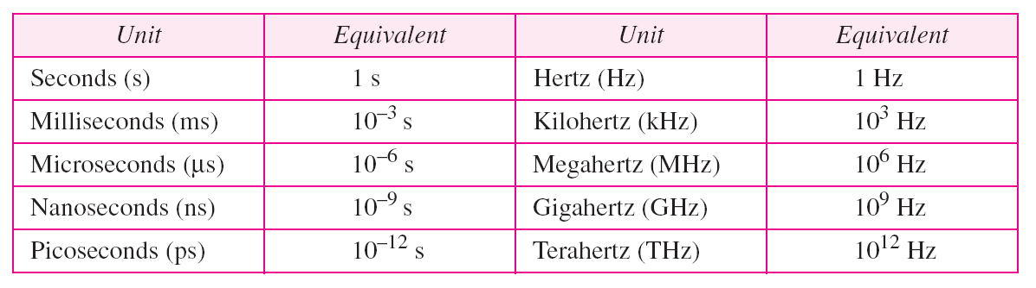
Period and Frequency (Cont.)
Units of period and frequency

Slide 8
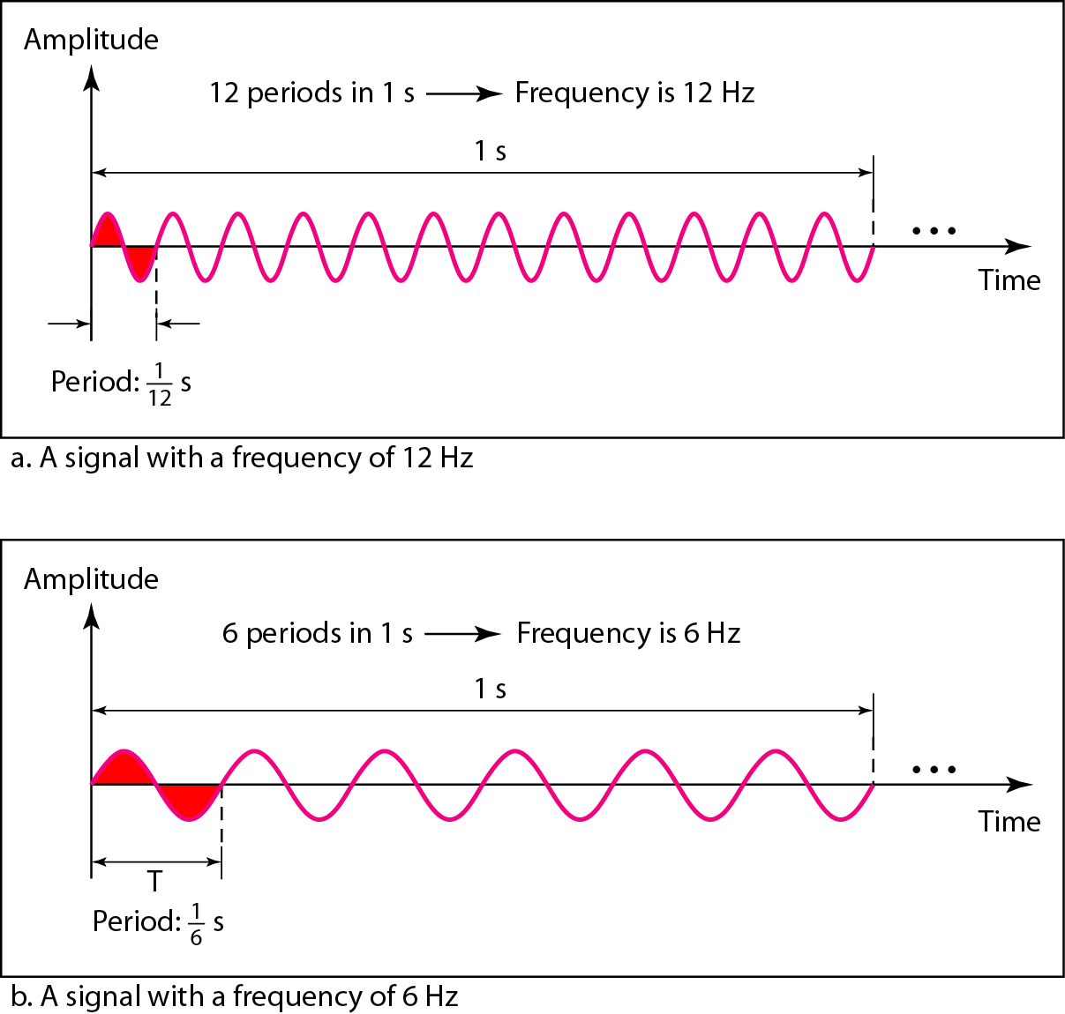
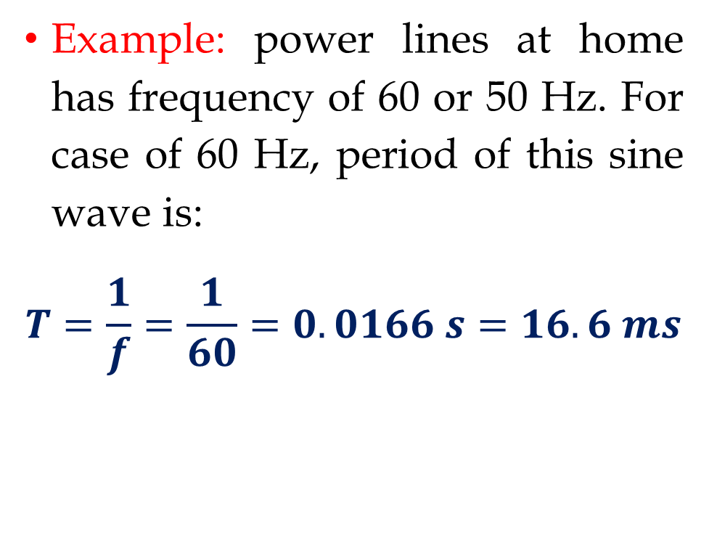
Period and Frequency (Cont.)
Example: power lines at home has frequency of 60 or 50 Hz. For case of 60 Hz, period of this sine wave is:
$$T=\frac{1}{f}=\frac{1}{60}=0.0166 s=16.6 ms$$

Slide 9
Time and Frequency Domains
Two domains are used for representing signals:
Time-domain: shows changes in signal amplitude w.r.t. time (amplitude vs. time plot).
Frequency-domain: shows relationship between peak amplitude and frequency.
The frequency domain is more compact and useful when we are dealing with more than one sine wave.

Slide 10
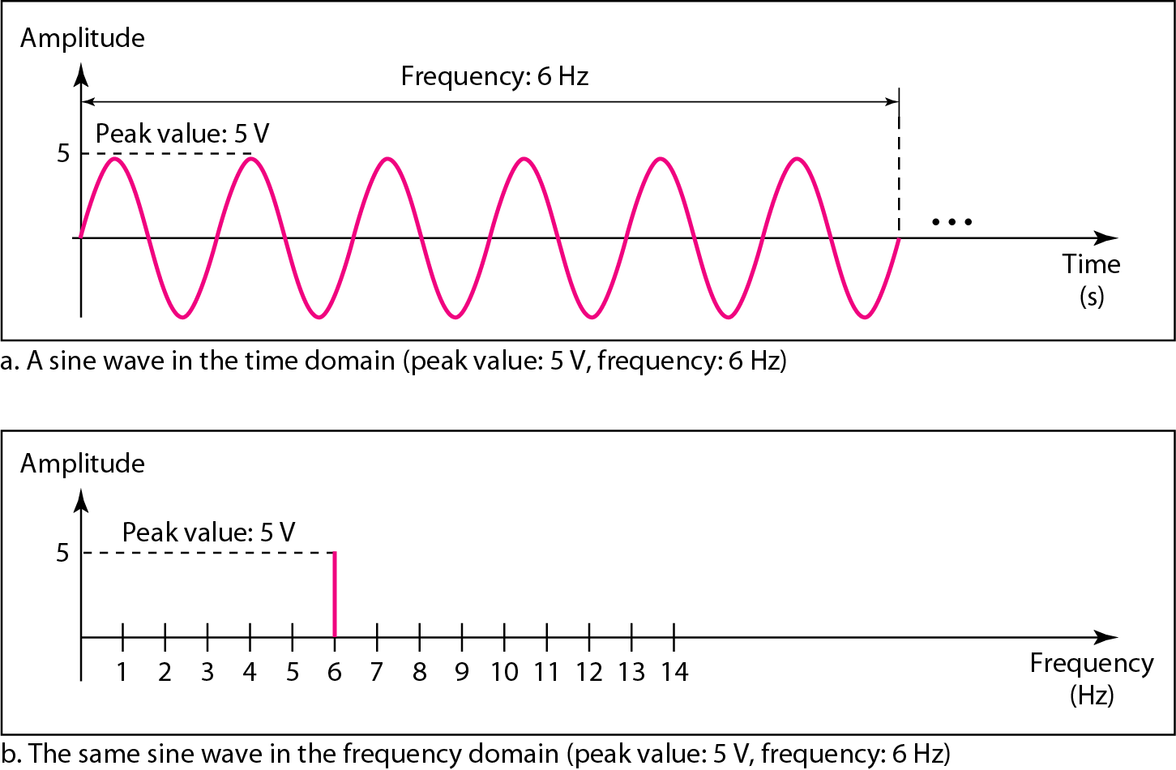
Time and Frequency Domains (Cont.)

Slide 11
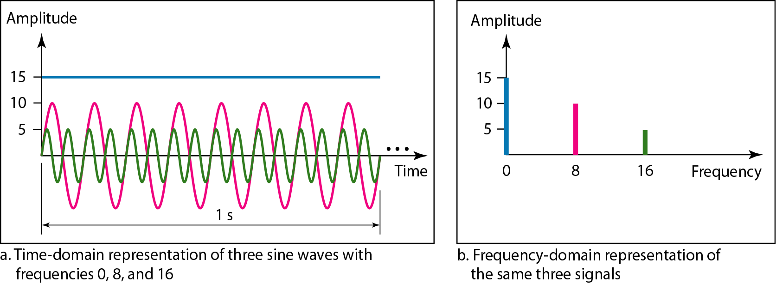
Time and Frequency Domains (Cont.)

Slide 12
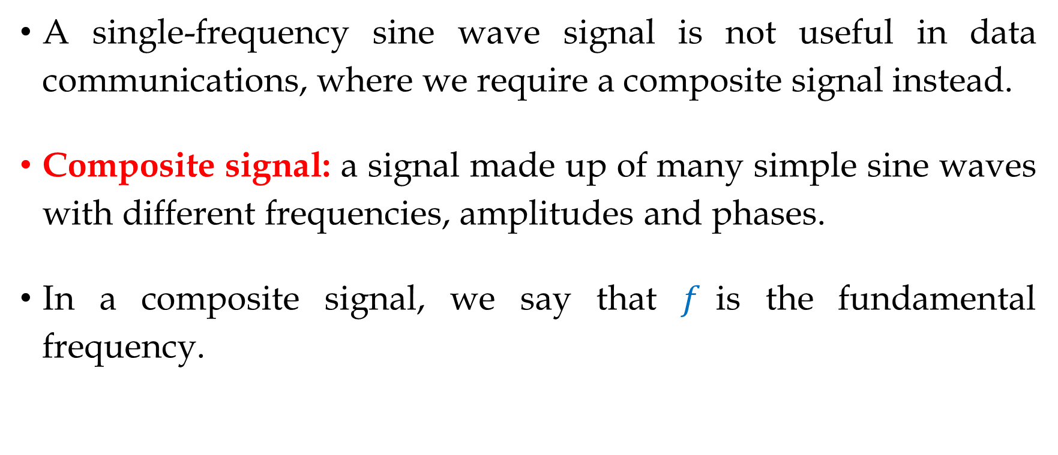
Composite Signals
A single-frequency sine wave signal is not useful in data communications, where we require a composite signal instead.
Composite signal: a signal made up of many simple sine waves with different frequencies, amplitudes and phases.
In a composite signal, we say that $f$is the fundamental frequency.

Slide 13
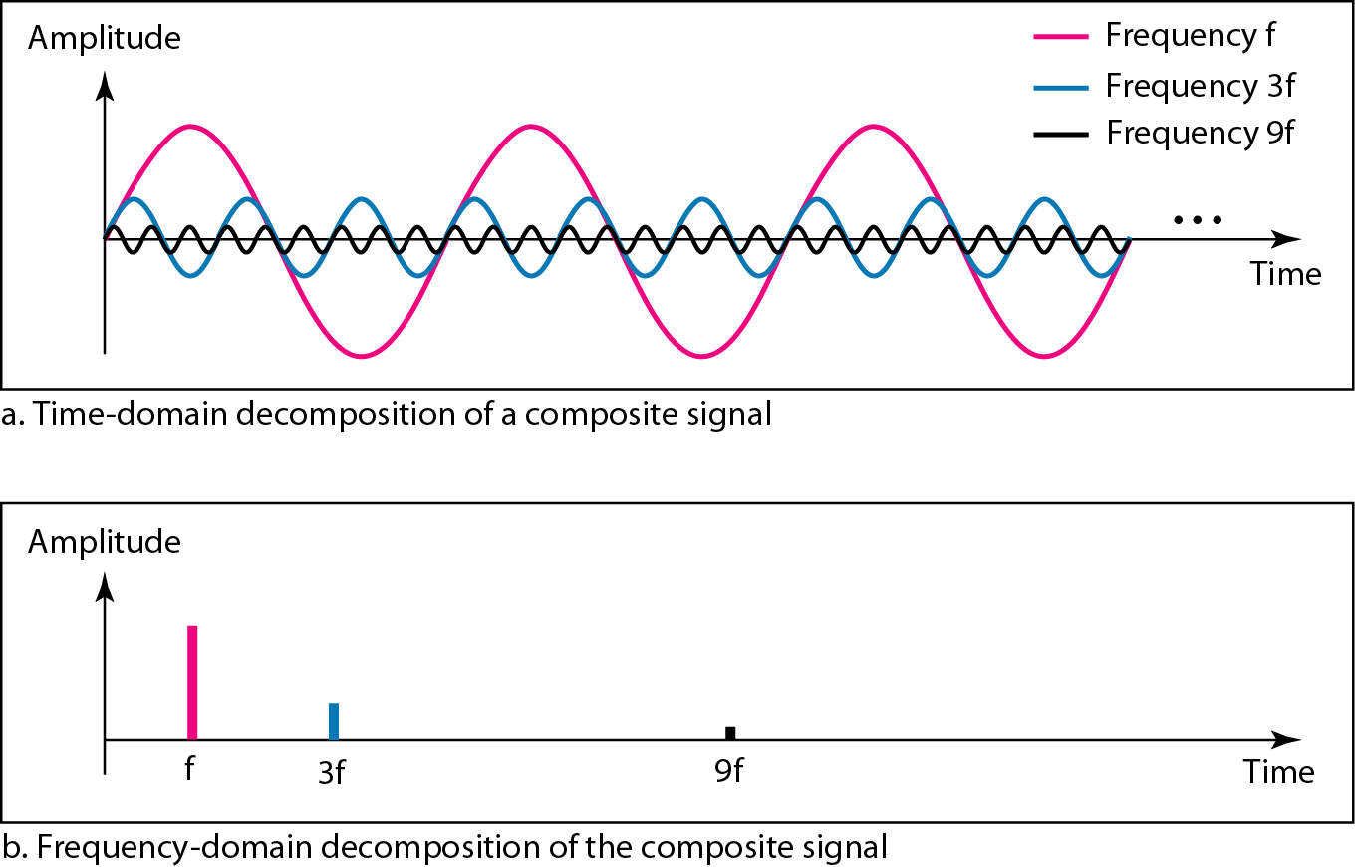
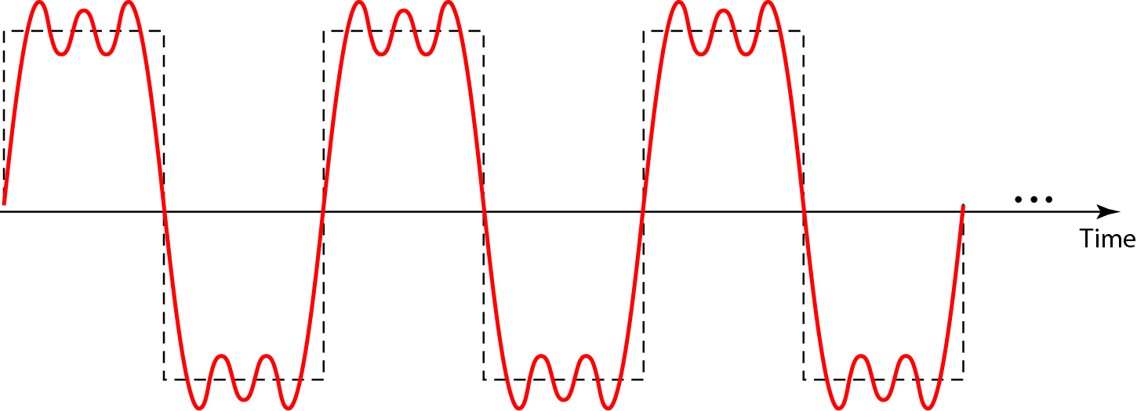
Composite Signals (Cont.)
A composite periodic signal
Decomposition of a composite periodic signal in the time and frequency domains

Slide 14
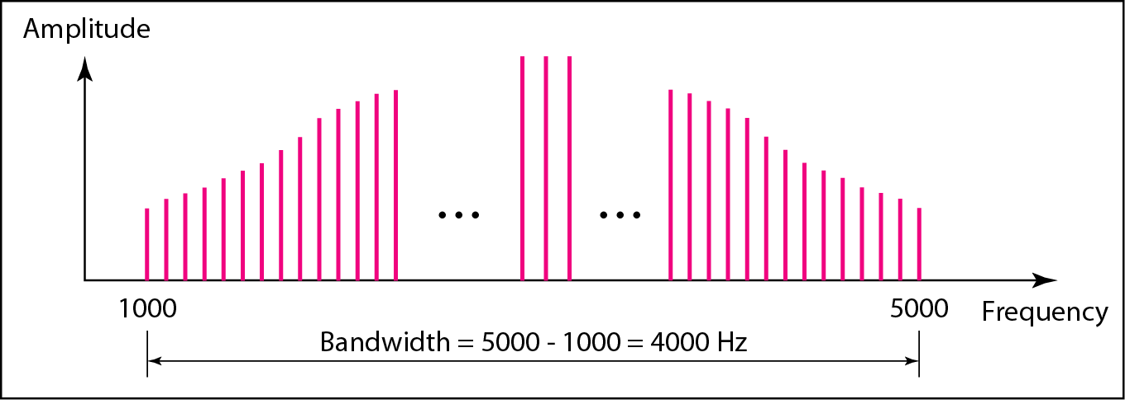
Bandwidth
Bandwidth: the range of frequencies contained in a composite signal, and is measured in hertz.
Bandwidth of a composite signal is the difference between the highest and the lowest frequencies contained in that signal.
The bandwidth of a periodic composite signals

Slide 15
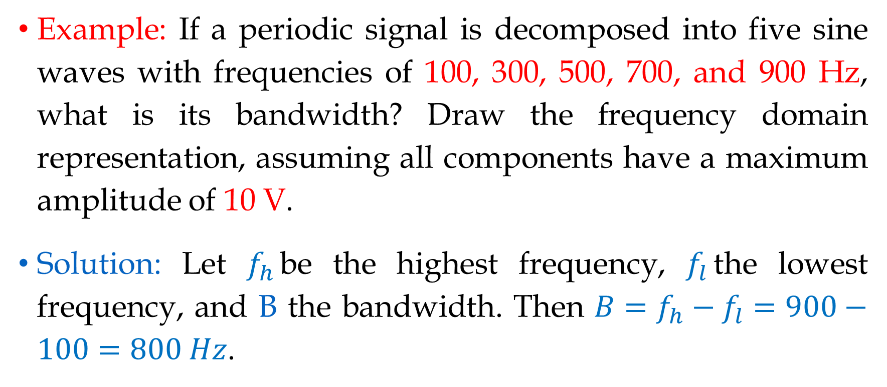
Bandwidth (Cont.)
Example: If a periodic signal is decomposed into five sine waves with frequencies of 100, 300, 500, 700, and 900 Hz, what is its bandwidth? Draw the frequency domain representation, assuming all components have a maximum amplitude of 10 V.
Solution: Let $f_{h}$be the highest frequency, $f_{l}$the lowest frequency, and B the bandwidth. Then $B=f_{h}−f_{l}=900−100=800 Hz$.

Slide 16
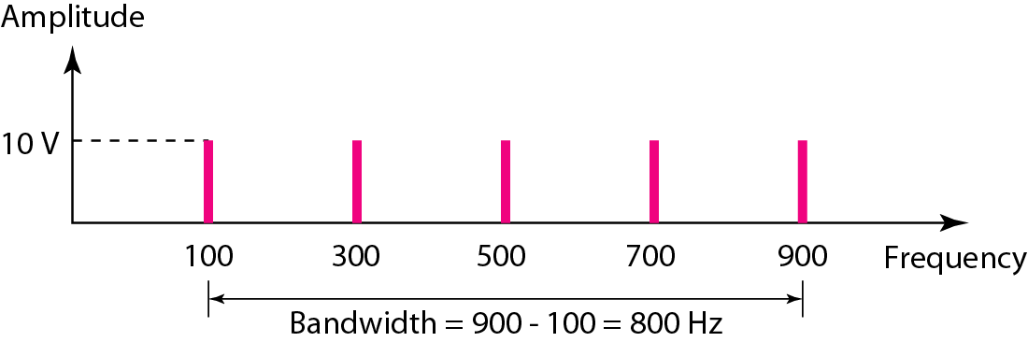
Bandwidth (Cont.)

Slide 17
Digital Signal

Slide 18
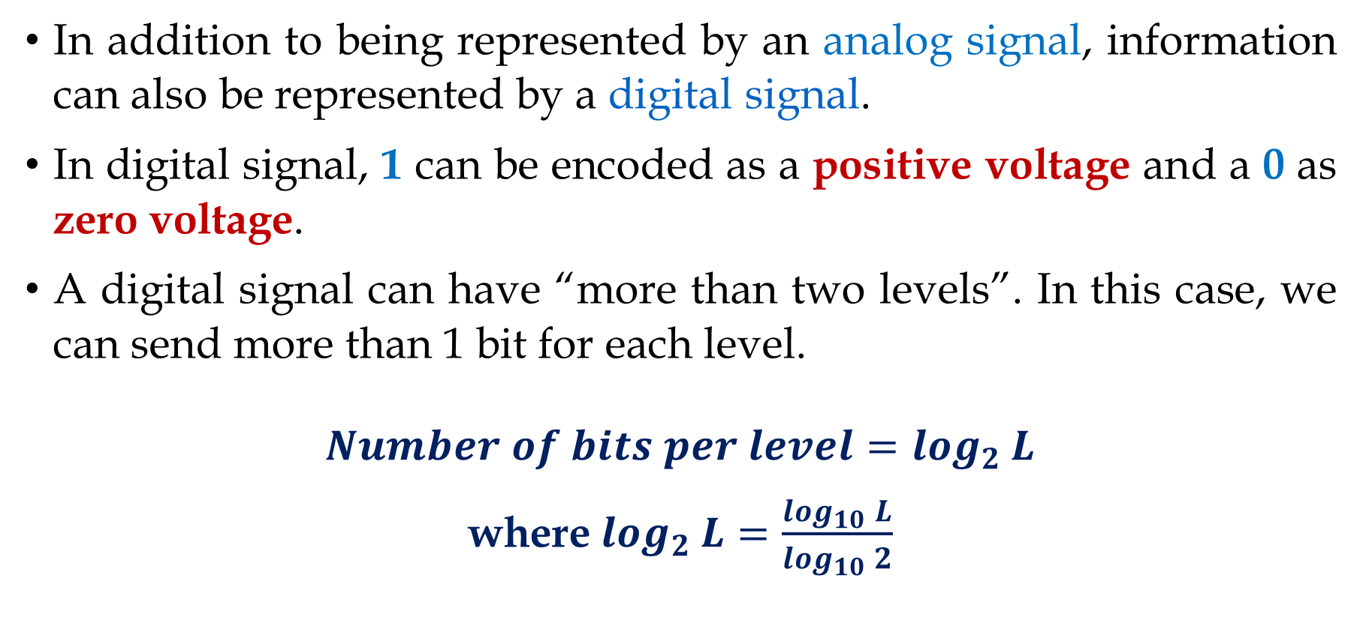
Digital Signal
In addition to being represented by an analog signal, information can also be represented by a digital signal.
In digital signal, 1 can be encoded as a positive voltage and a 0 as zero voltage.
A digital signal can have “more than two levels”. In this case, we can send more than 1 bit for each level.
$Number of bits per level=\log_{2}{L}$
where$\log_{2}{L}=\frac{\log_{10}{L}}{\log_{10}{2}}$

Slide 19
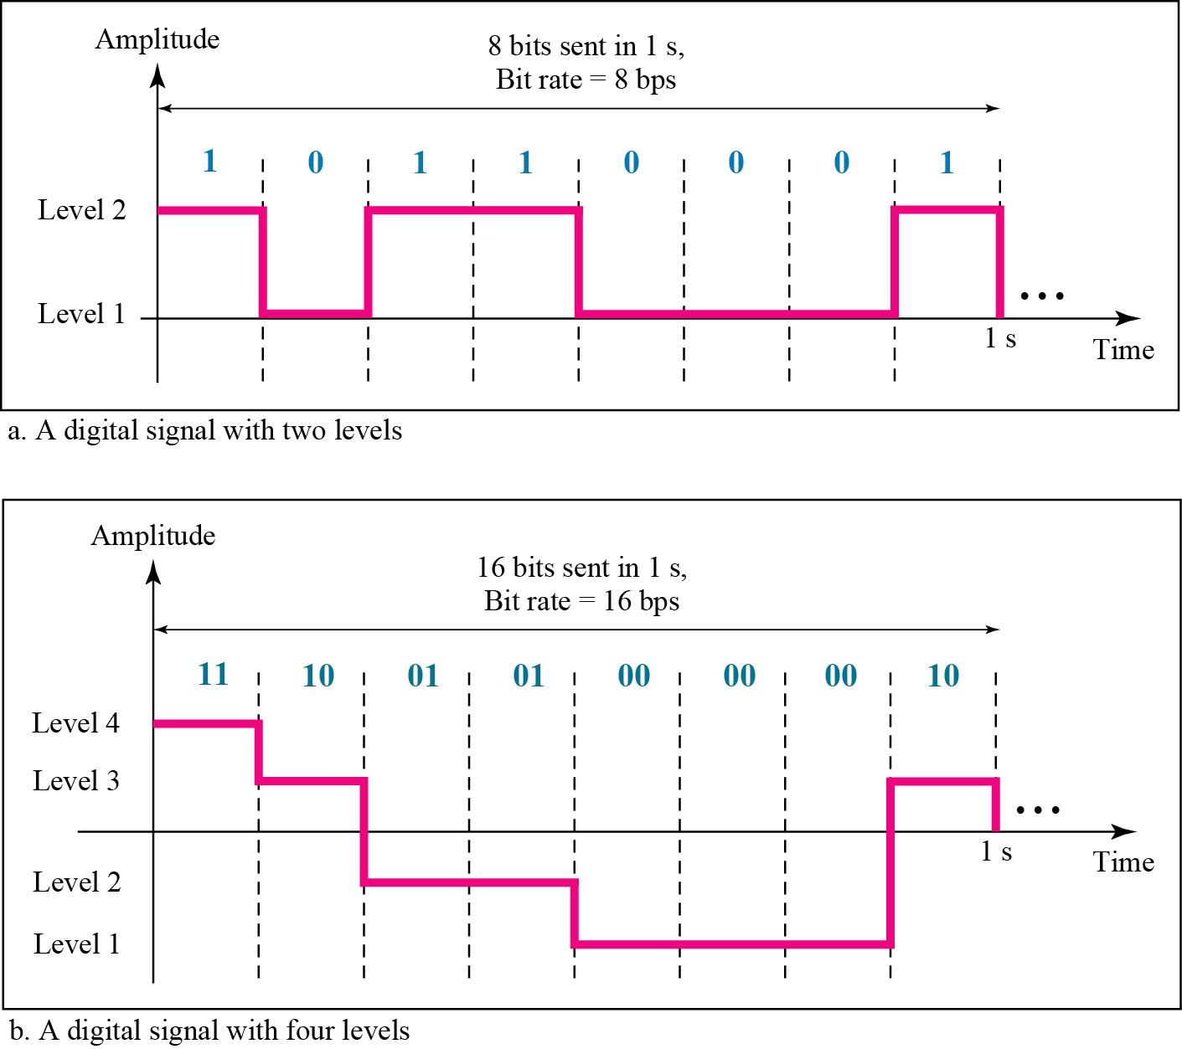
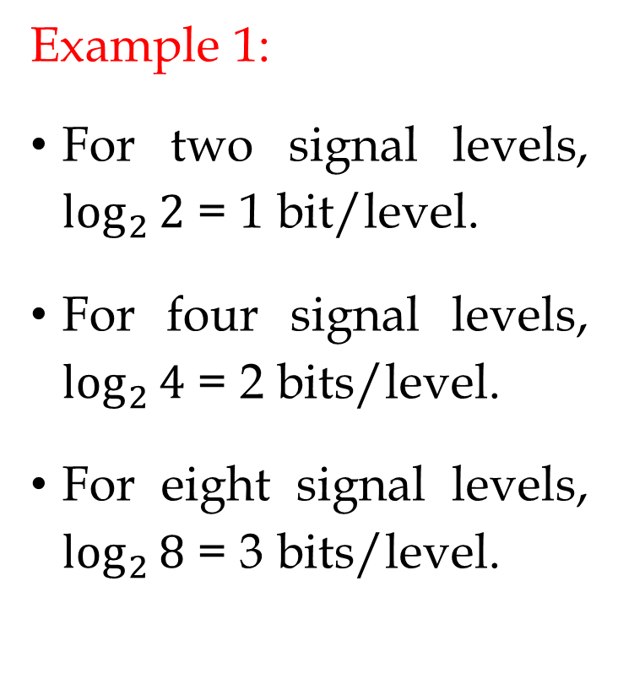
Example 1:
For two signal levels, $\log_{2}{2}$= 1 bit/level.
For four signal levels, $\log_{2}{4}$= 2 bits/level.
For eight signal levels, $\log_{2}{8}$= 3 bits/level.

Slide 20
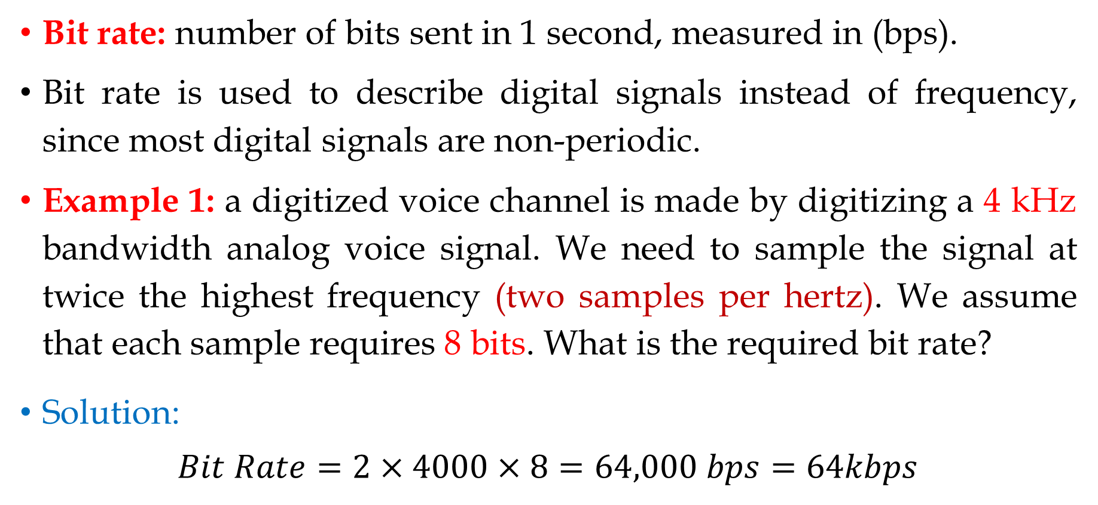
Bit Rate
Bit rate: number of bits sent in 1 second, measured in (bps).
Bit rate is used to describe digital signals instead of frequency, since most digital signals are non-periodic.
Example 1: a digitized voice channel is made by digitizing a 4 kHz bandwidth analog voice signal. We need to sample the signal at twice the highest frequency (two samples per hertz). We assume that each sample requires 8 bits. What is the required bit rate?
Solution:
$$Bit Rate=2×4000×8=64,000 bps=64kbps$$

Slide 21
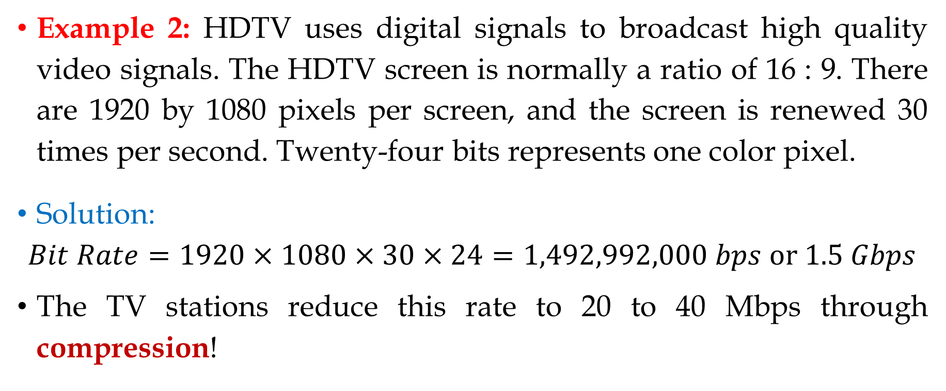
Bit Rate (Cont.)
Example 2: HDTV uses digital signals to broadcast high quality video signals. The HDTV screen is normally a ratio of 16 : 9. There are 1920 by 1080 pixels per screen, and the screen is renewed 30 times per second. Twenty-four bits represents one color pixel.
Solution:
$$Bit Rate=1920×1080×30×24=1,492,992,000 bps or 1.5 Gbps$$
The TV stations reduce this rate to 20 to 40 Mbps through compression!

Slide 22
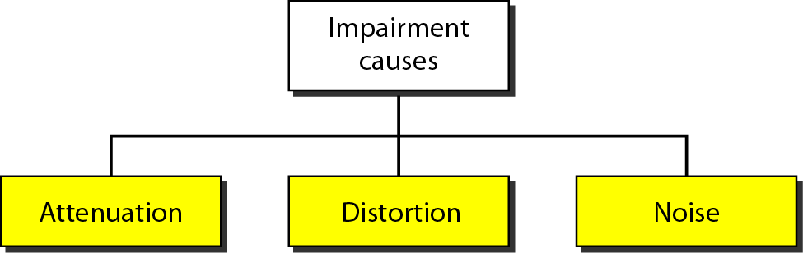
Transmission Impairments
Transmission media are not perfect, causing signal impairment. As a result, a signal that is sent is not what is received.
Three causes of signal impairments are attenuation, distortion, and noise.

Slide 23
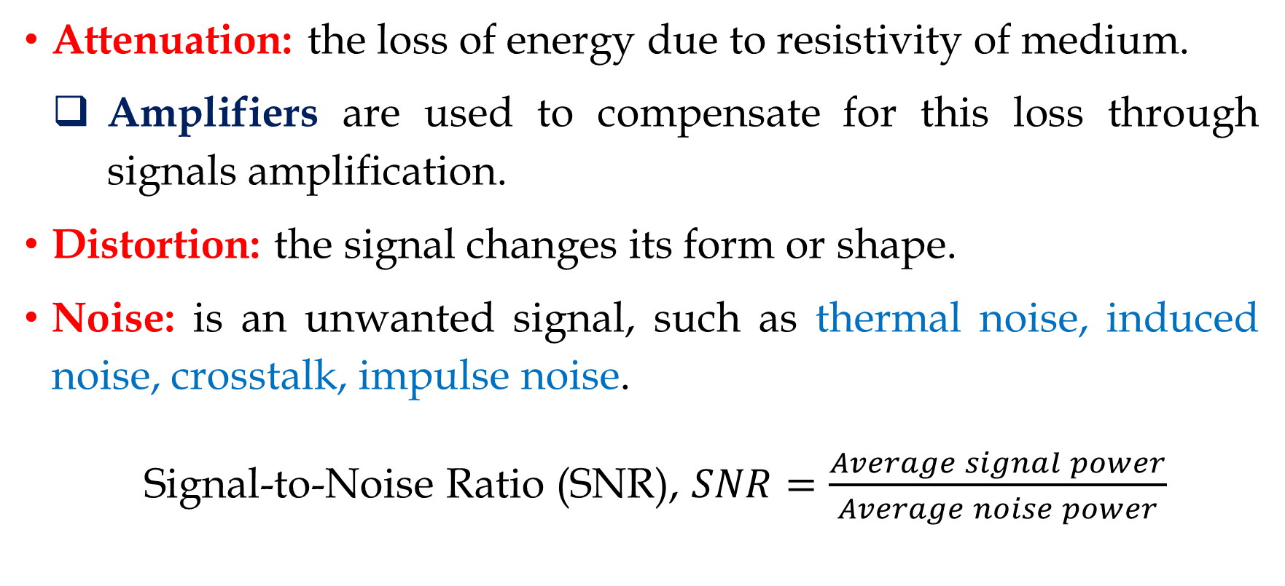
Transmission Impairments (Cont.)
Attenuation: the loss of energy due to resistivity of medium.
Amplifiers are used to compensate for this loss through signals amplification.
Distortion: the signal changes its form or shape.
Noise: is an unwanted signal, such as thermal noise, induced noise, crosstalk, impulse noise.
Signal-to-Noise Ratio (SNR), $SNR=\frac{Average signal power}{Average noise power}$

Slide 24
Data Rate Limits
Data rate limits depends on three factors:
The bandwidth available
The level of the signals we use
The quality of the channel (such as level of noise)
Two theoretical formulas to calculate data rate:
Nyquist for noiseless channel
Shannon for noisy channel

Slide 25
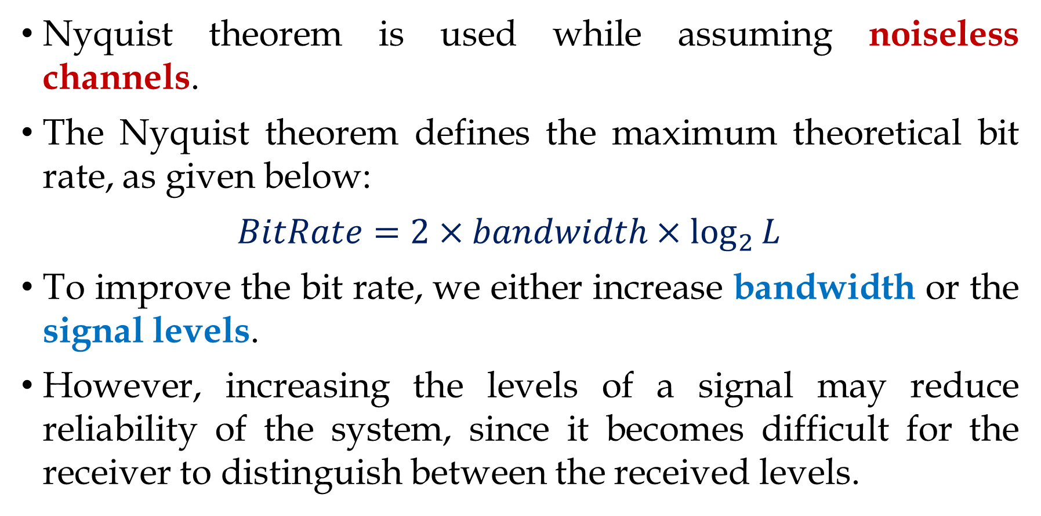
Nyquist Theorem
Nyquist theorem is used while assuming noiseless channels.
The Nyquist theorem defines the maximum theoretical bit rate, as given below:
$$BitRate=2×bandwidth×\log_{2}{L}$$
To improve the bit rate, we either increase bandwidth or the signal levels.
However, increasing the levels of a signal may reduce reliability of the system, since it becomes difficult for the receiver to distinguish between the received levels.

Slide 26
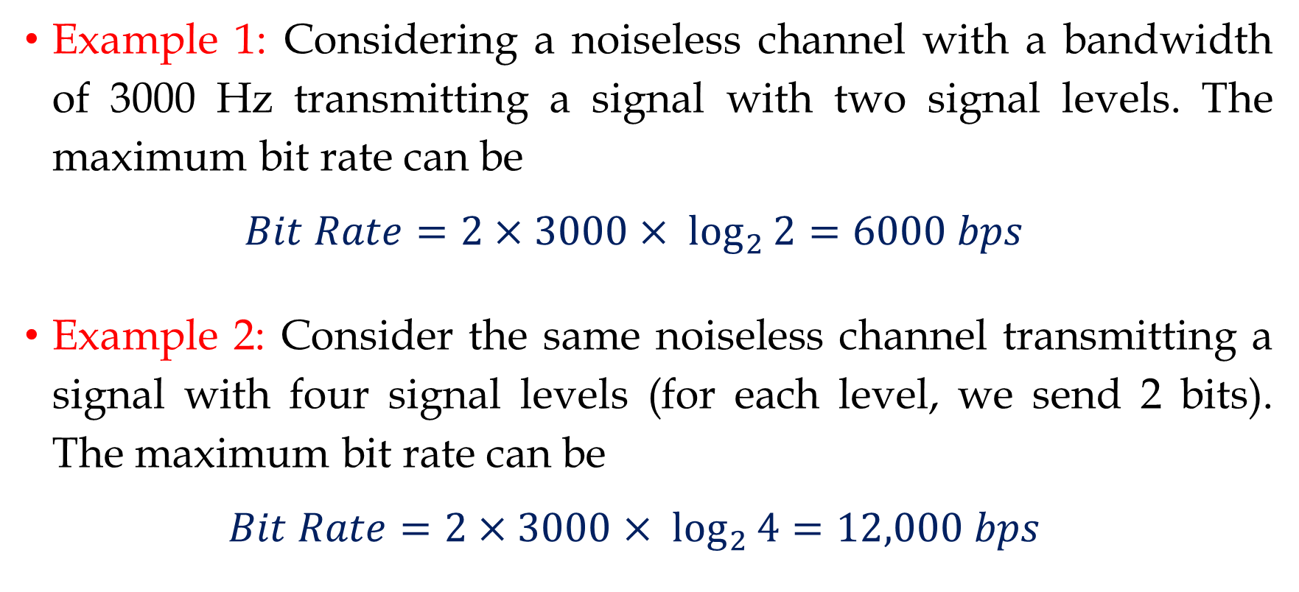
Nyquist Theorem (Cont.)
Example 1: Considering a noiseless channel with a bandwidth of 3000 Hz transmitting a signal with two signal levels. The maximum bit rate can be
$$Bit Rate=2×3000× \log_{2}{2}=6000 bps$$
Example 2: Consider the same noiseless channel transmitting a signal with four signal levels (for each level, we send 2 bits). The maximum bit rate can be
$$Bit Rate=2×3000× \log_{2}{4}=12,000 bps$$

Slide 27
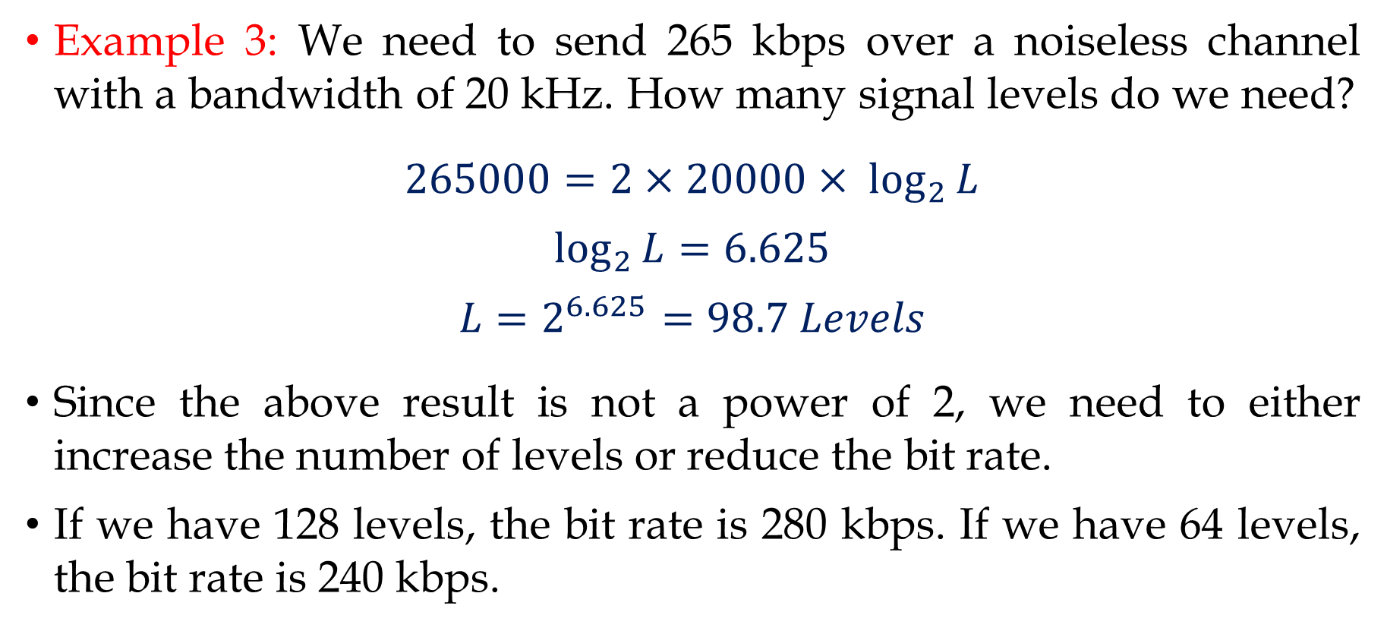
Nyquist Theorem (Cont.)
Example 3: We need to send 265 kbps over a noiseless channel with a bandwidth of 20 kHz. How many signal levels do we need?
$$265000=2×20000× \log_{2}{L}$$
$$\log_{2}{L}=6.625$$
$$L=2^{6.625}=98.7 Levels$$
Since the above result is not a power of 2, we need to either increase the number of levels or reduce the bit rate.
If we have 128 levels, the bit rate is 280 kbps. If we have 64 levels, the bit rate is 240 kbps.

Slide 28
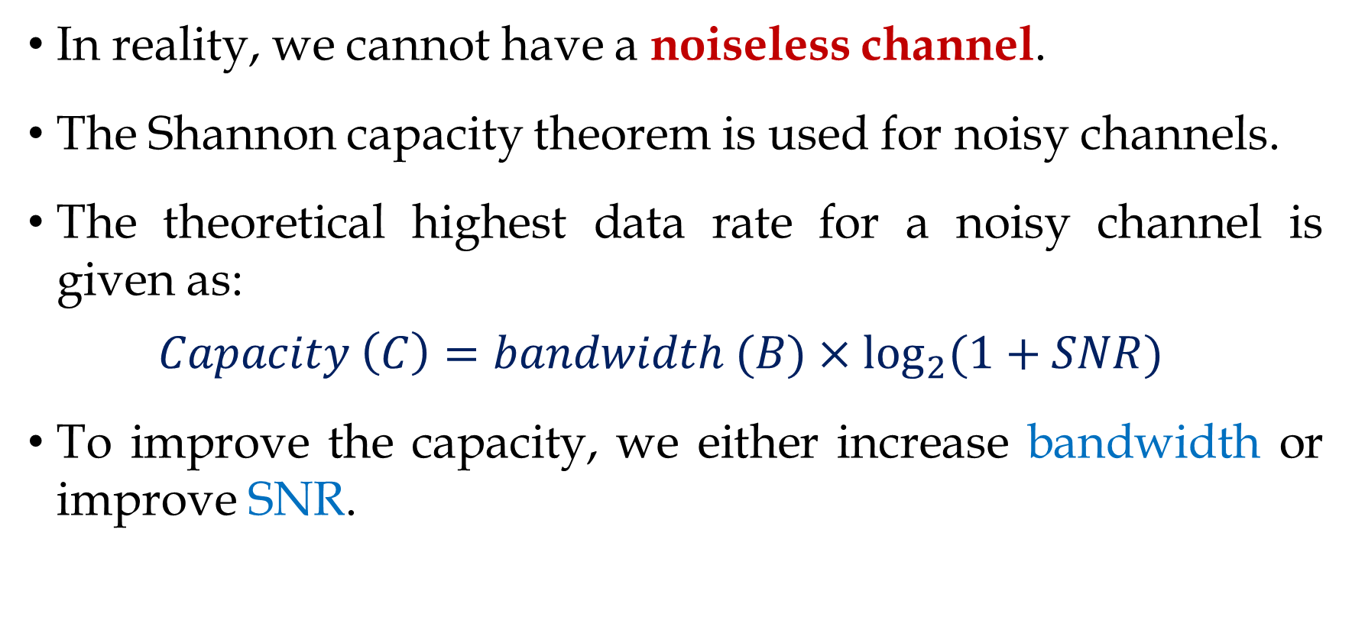
Shannon Capacity
In reality, we cannot have a noiseless channel.
The Shannon capacity theorem is used for noisy channels.
The theoretical highest data rate for a noisy channel is given as:
$$Capacity \left(C\right)=bandwidth (B)×\log_{2}{(1+SNR)}$$
To improve the capacity, we either increase bandwidth or improve SNR.

Slide 29

Shannon Capacity (Cont.)
The SNR is often given in decibels, where:
$${SNR}_{dB}=10\log_{10}{SNR}$$
$$SNR={10}^{({{SNR}_{dB}}/{10})}$$

Slide 30
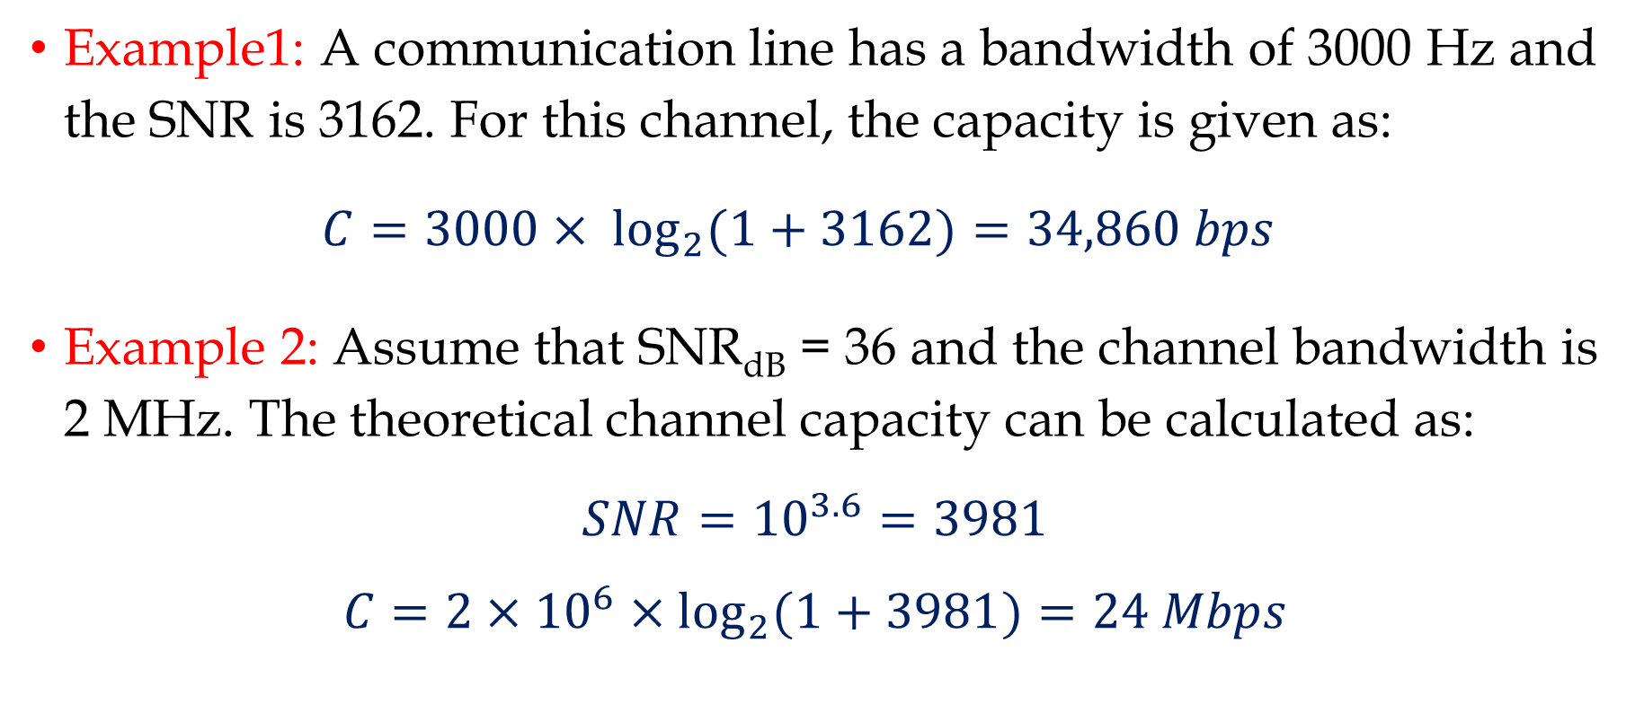
Shannon Capacity (Cont.)
Example1: A communication line has a bandwidth of 3000 Hz and the SNR is 3162. For this channel, the capacity is given as:
$$C=3000× \log_{2}{(1+3162)}=34,860 bps$$
Example 2: Assume that SNR_{dB} = 36 and the channel bandwidth is 2 MHz. The theoretical channel capacity can be calculated as:
$$SNR={10}^{3.6}=3981$$
$$C=2×{10}^{6}×\log_{2}{(1+3981)}=24 Mbps$$

Slide 31
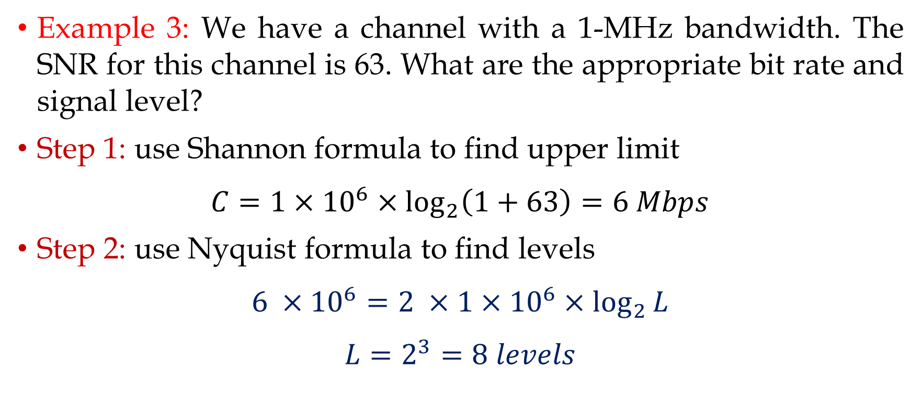
Shannon Capacity (Cont.)
Example 3: We have a channel with a 1-MHz bandwidth. The SNR for this channel is 63. What are the appropriate bit rate and signal level?
Step 1: use Shannon formula to find upper limit
$$C=1×{10}^{6}×\log_{2}\left(1+63\right)=6 Mbps$$
Step 2: use Nyquist formula to find levels
$$6 ×{10}^{6}=2 ×1×{10}^{6}×\log_{2}{L}$$
$$L=2^{3}=8 levels$$

Slide 32
Performance

Slide 33
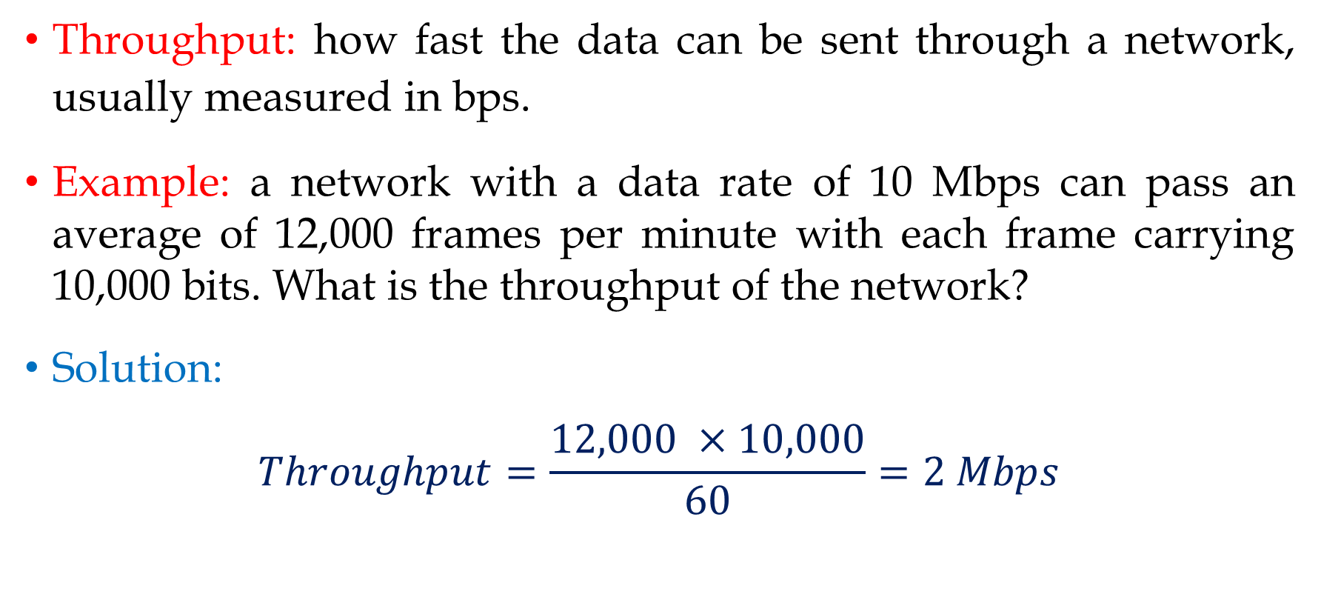
Throughput
Throughput: how fast the data can be sent through a network, usually measured in bps.
Example: a network with a data rate of 10 Mbps can pass an average of 12,000 frames per minute with each frame carrying 10,000 bits. What is the throughput of the network?
Solution:
$$Throughput=\frac{12,000 ×10,000}{60}=2 Mbps$$

Slide 34
Latency
Latency (Delay): the time it takes for a message to completely arrive at destination from the time the first bit is sent out from the source.
Latency is made of four components:
𝐿𝑎𝑡𝑒𝑛𝑐𝑦 = 𝑝𝑟𝑜𝑝𝑎𝑔𝑎𝑡𝑖𝑜𝑛 𝑡𝑖𝑚𝑒 + 𝑡𝑟𝑎𝑛𝑠𝑚𝑖𝑠𝑠𝑖𝑜𝑛 𝑡𝑖𝑚𝑒 +
𝑞𝑢𝑒𝑢𝑖𝑛𝑔 𝑡𝑖𝑚𝑒 + 𝑝𝑟𝑜𝑐𝑒𝑠𝑠𝑖𝑛𝑔 𝑡𝑖𝑚𝑒

Slide 35
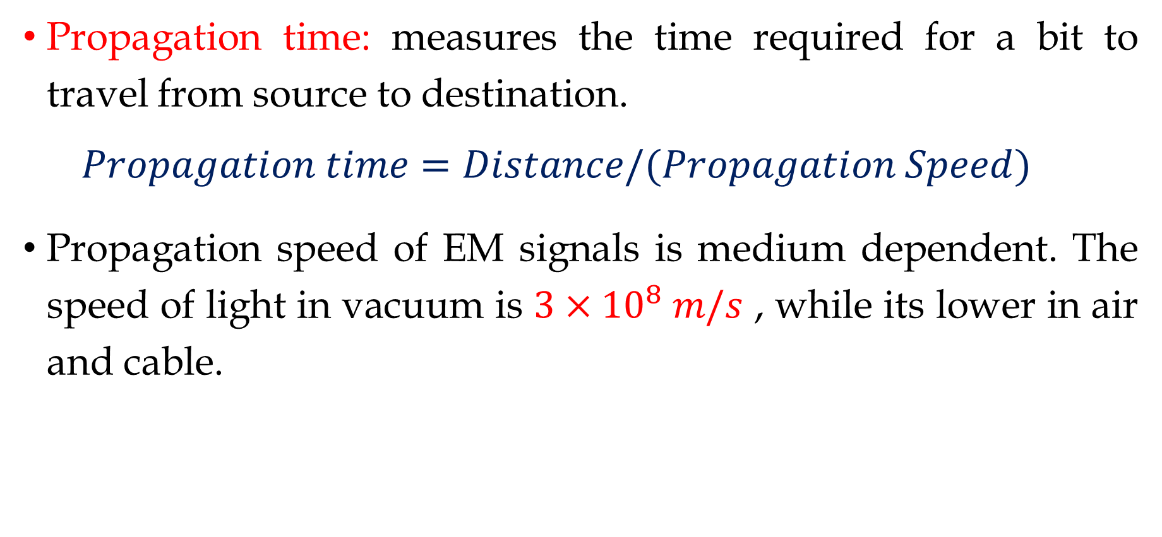
Latency: Propagation Time
Propagation time: measures the time required for a bit to travel from source to destination.
$$Propagation time=Distance/(Propagation Speed)$$
Propagation speed of EM signals is medium dependent. The speed of light in vacuum is $3×{10}^{8} m/s$ , while its lower in air and cable.

Slide 36
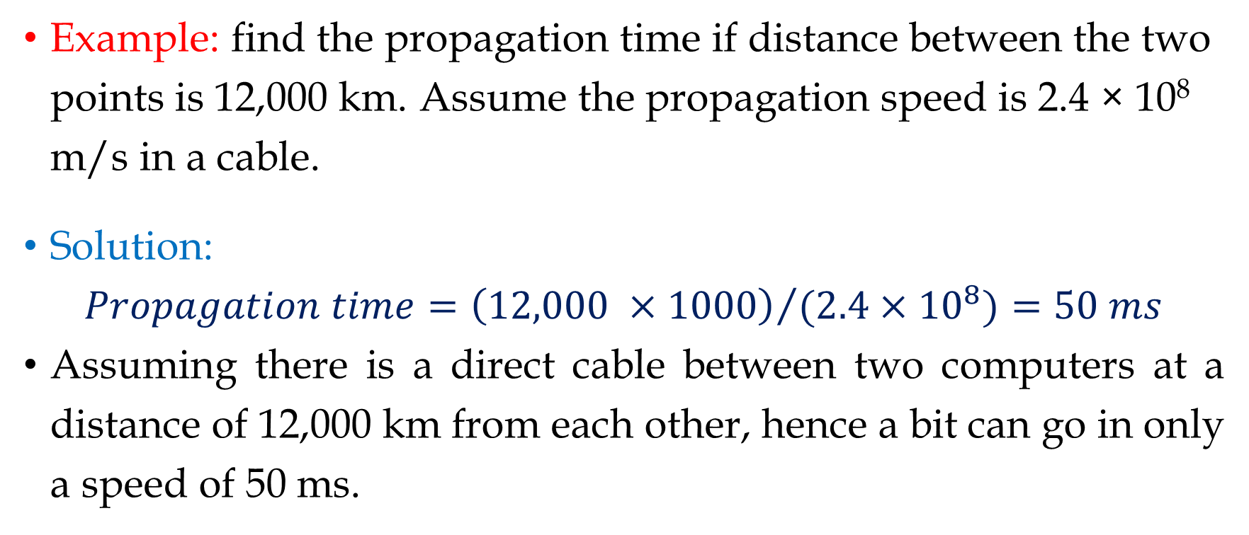
Latency: Propagation Time (Cont.)
Example: find the propagation time if distance between the two points is 12,000 km. Assume the propagation speed is 2.4 × 10⁸ m/s in a cable.
Solution:
$$Propagation time={\left(12,000 ×1000\right)}/{(2.4×{10}^{8})}=50 ms$$
Assuming there is a direct cable between two computers at a distance of 12,000 km from each other, hence a bit can go in only a speed of 50 ms.

Slide 37
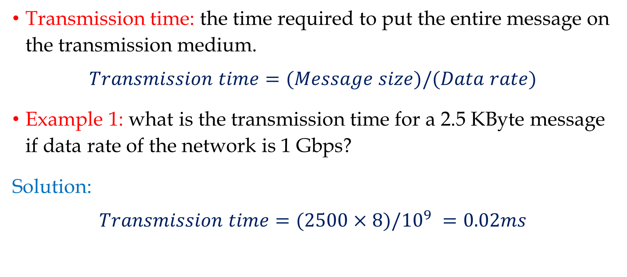
Latency: Transmission Time
Transmission time: the time required to put the entire message on the transmission medium.
$$Transmission time=(Message size)/(Data rate)$$
Example 1: what is the transmission time for a 2.5 KByte message if data rate of the network is 1 Gbps?
Solution:
$$Transmission time=(2500×8)/{10}^{9} =0.02ms$$

Slide 38
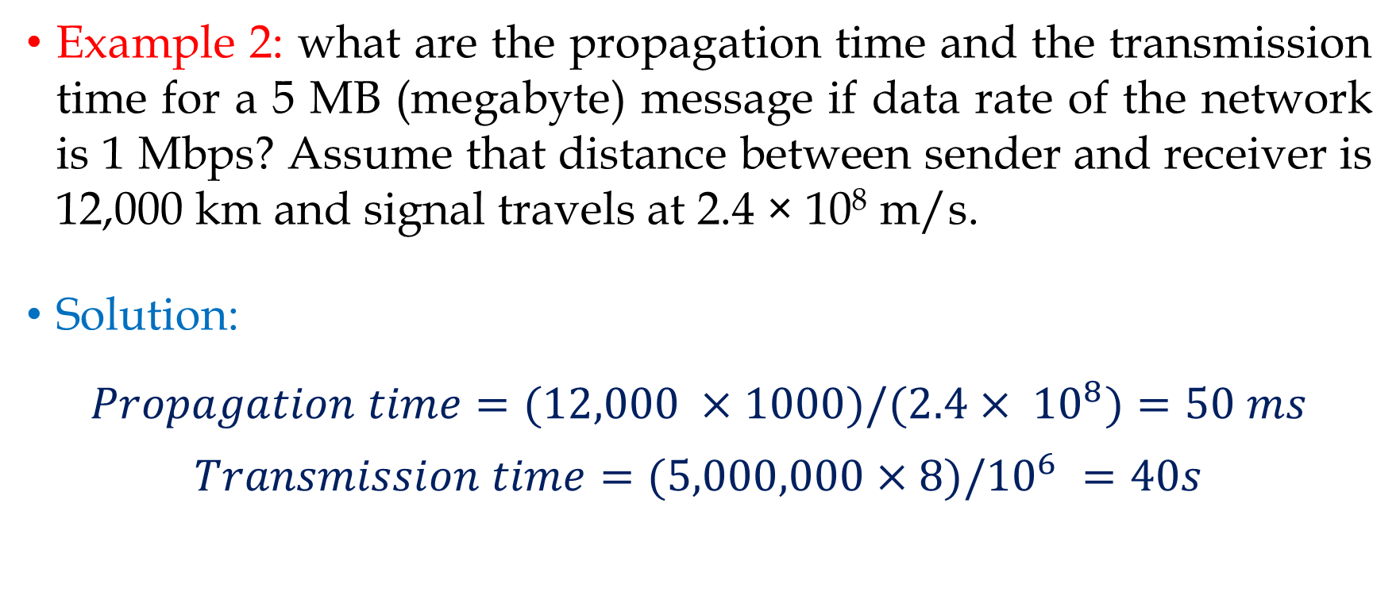
Latency: Transmission Time (Cont.)
Example 2: what are the propagation time and the transmission time for a 5 MB (megabyte) message if data rate of the network is 1 Mbps? Assume that distance between sender and receiver is 12,000 km and signal travels at 2.4 × 10⁸ m/s.
Solution:
$$Propagation time=(12,000 ×1000)/(2.4× {10}^{8})=50 ms$$
$$Transmission time=(5,000,000×8)/{10}^{6} =40s$$

Slide 39
Latency: Queuing & Processing Time
Queuing time: the time needed for each device on the network to hold the message before it can be processed.
The queuing time changes with the load imposed on the network, where as the network traffic increases, the queuing time increases.
Processing delay: the time required for a device, such as a router, to process a message, such as packet header.
The processing delay is usually very small, hence negligible.

Slide 40
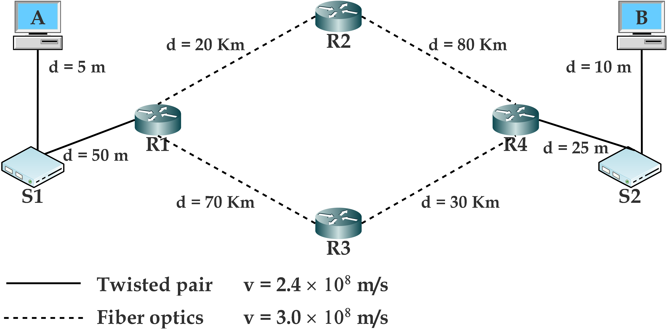
Latency Example
In the illustrated network, select only one communication path among the two possible paths between nodes A and B, then calculate the total delay required for a packet of size 512 KBytes to be sent from A to B.

Slide 41
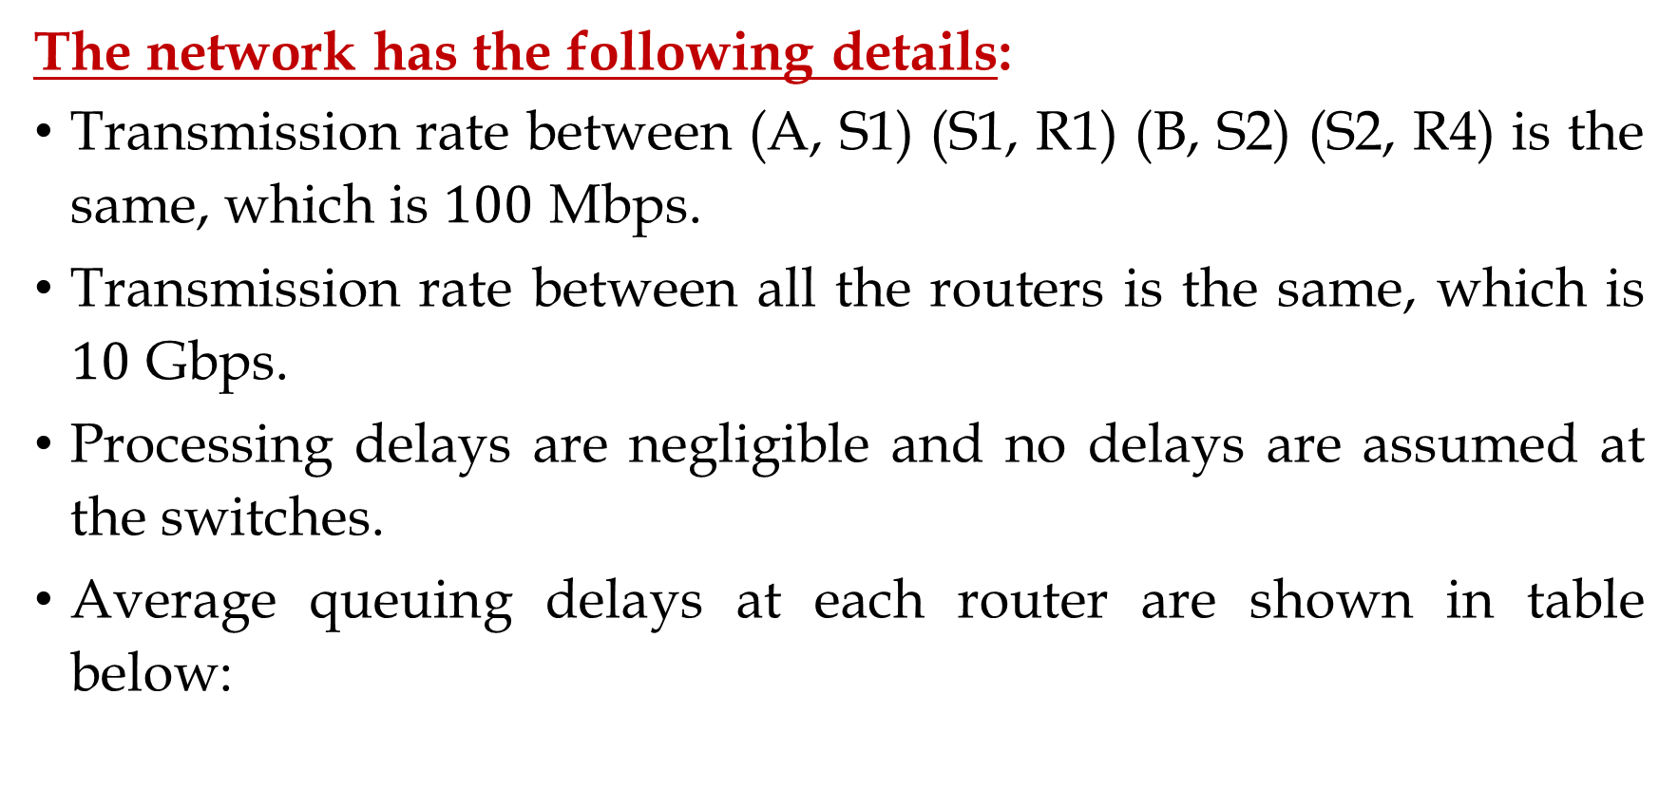
Latency Example (Cont.)
The network has the following details:
Transmission rate between (A, S1) (S1, R1) (B, S2) (S2, R4) is the same, which is $100$ Mbps.
Transmission rate between all the routers is the same, which is $10$ Gbps.
Processing delays are negligible and no delays are assumed at the switches.
Average queuing delays at each router are shown in table below:

Slide 42
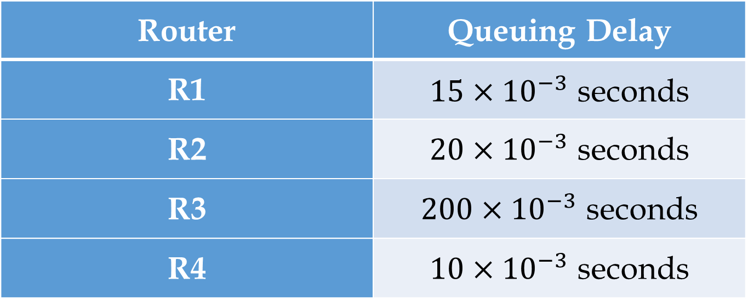
Latency Example (Cont.)
Router | Queuing Delay
R1 | $15×{10}^{−3}$ seconds
R2 | $20×{10}^{−3}$ seconds
R3 | $200×{10}^{−3}$ seconds
R4 | $10×{10}^{−3}$ seconds
Note: Mention the selected path name in your answer sheet, e.g. A-S1-R1-R2-R4-S2-B.

Slide 43
Thank You!

